Slide 1
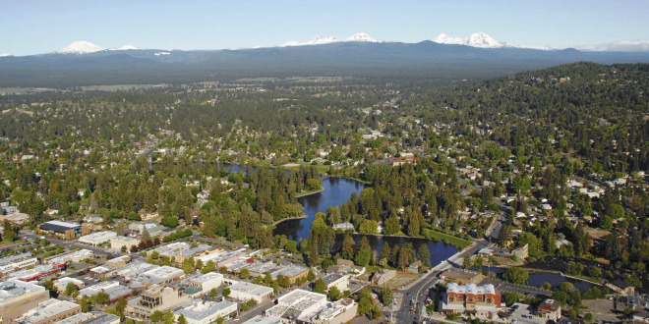
50 Years of the Oregon Land Use Act
Bill Fulton
City Club, Bend, Oregon
June 15, 2023

Slide 2
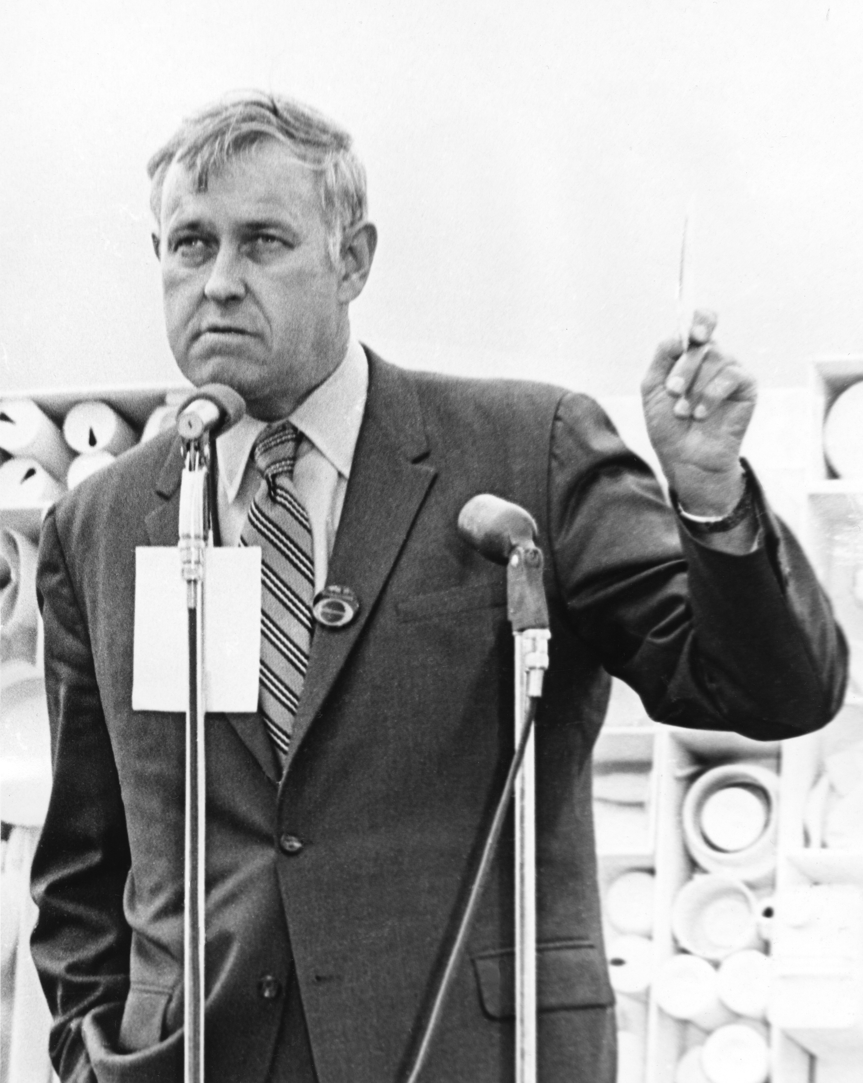
Gov. Tom McCall’s Famous 1973 Speech – Which Stimulated Passage of SB 100
“The interests of Oregon for today and in the future must be protected from the grasping wastrels of the land.
“Unlimited and unregulated growth leads inexorably to a lowered quality of life.”
‘

Slide 3
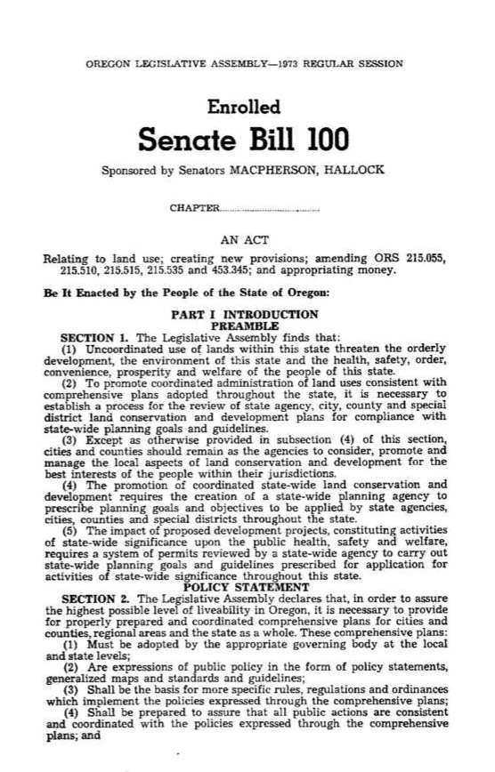
But McCall’s zealous advocacy of SB 100 didn’t come out of nowhere

Slide 4
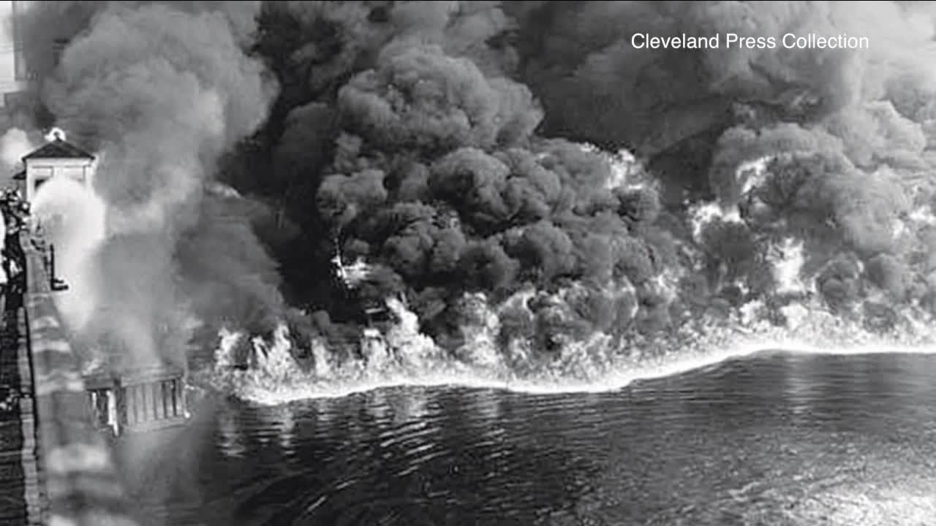
In the late ‘60s environmental concern became so intense …

Slide 5
… that even Sports Illustrated couldn’t ignore it.

Slide 6
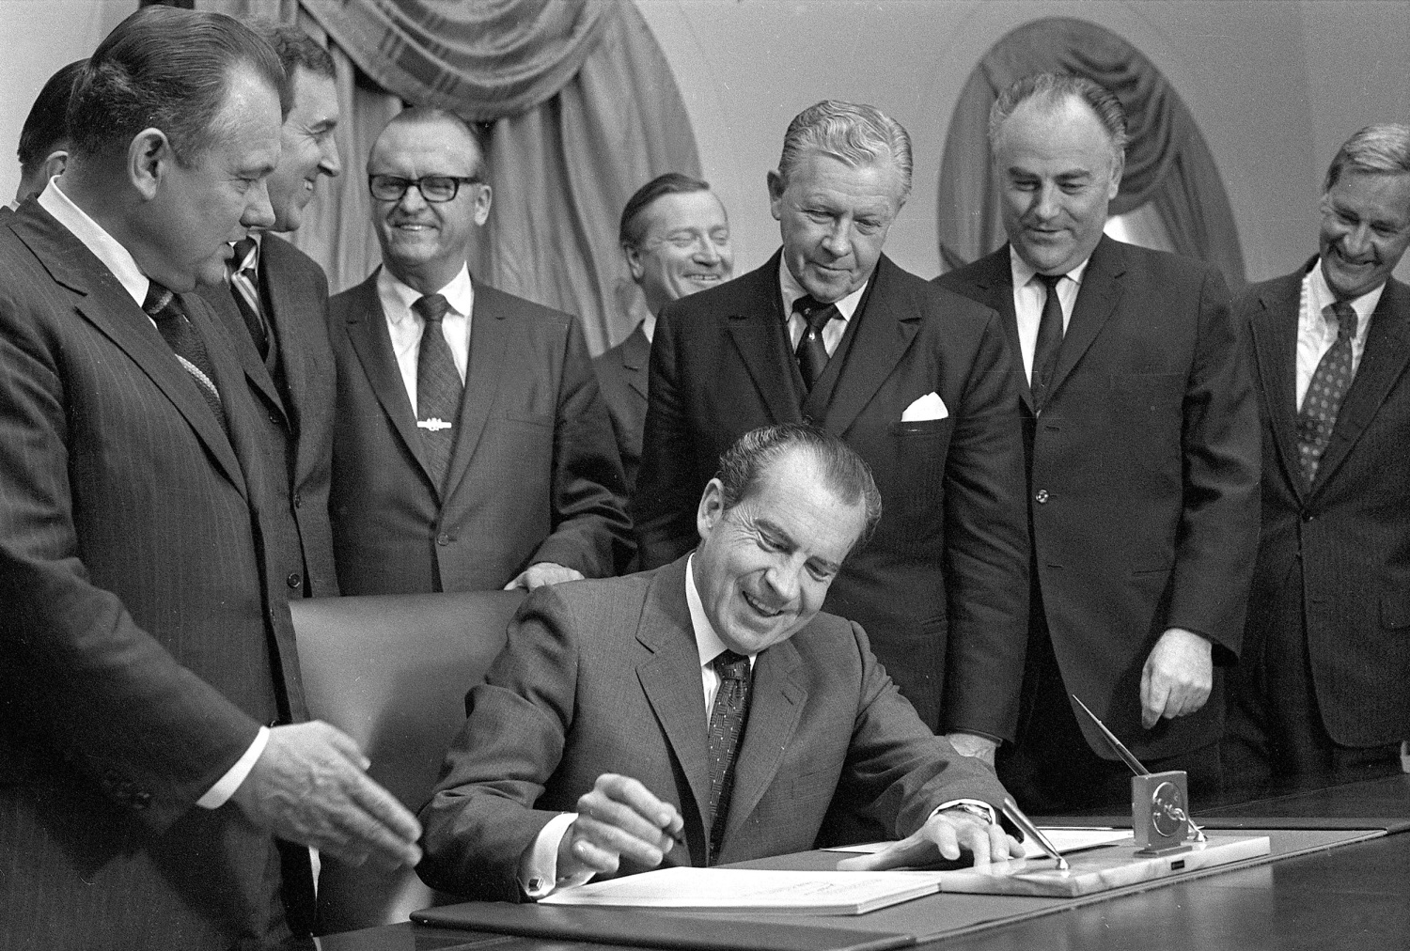
In 1970, this great environmental president signed NEPA

Slide 7
But that was not the end. Soon land use emerged as a pressing national issue …
The Use of Land (1973): “There is a new mood in America,” which is “questioning the pace and direction of continued urban development patterns”.
Many moderate Republicans were alarmed by the land use trend.

Slide 8
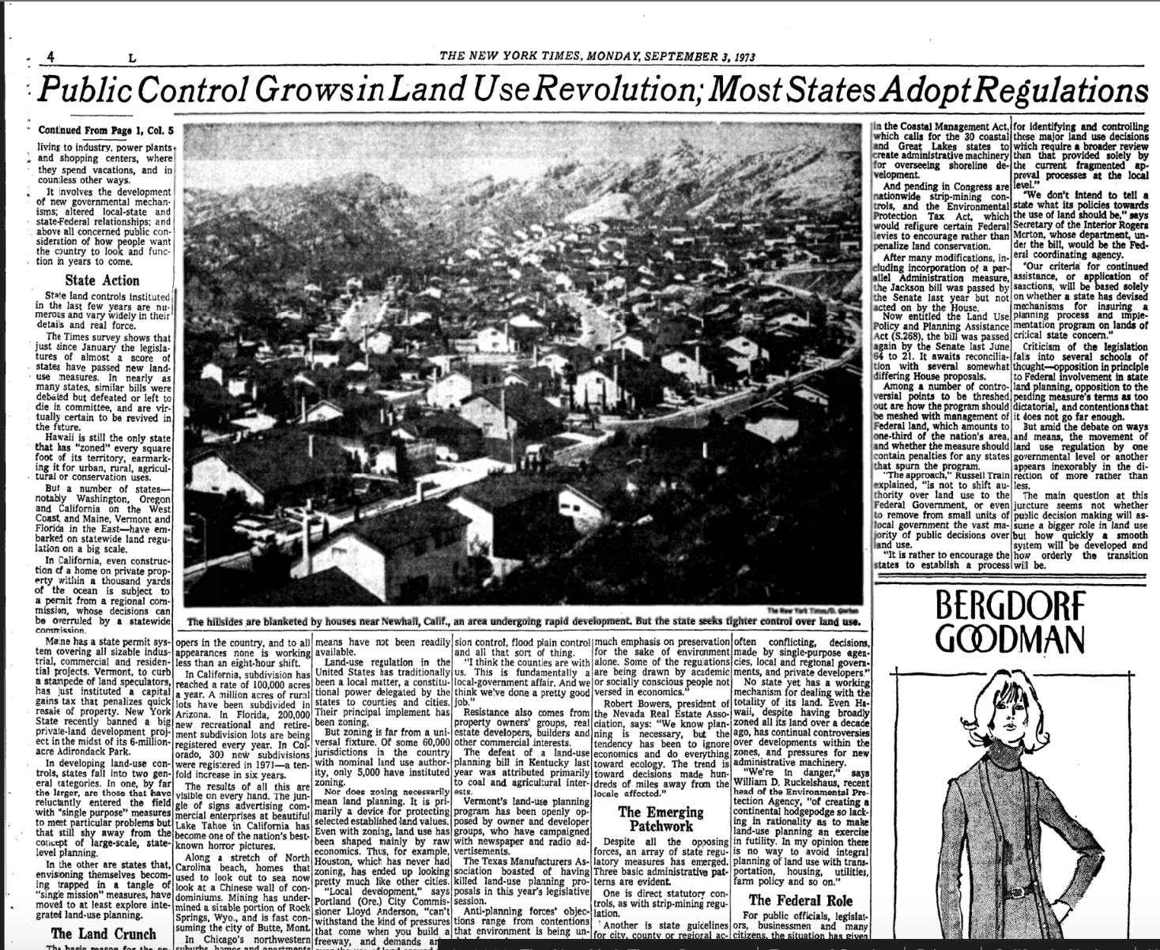
… and Oregon was only one of many states looking at how to curb sprawl

Slide 9
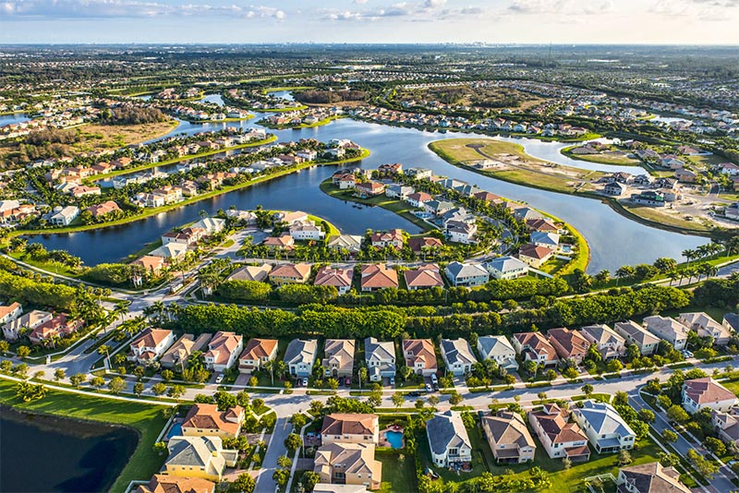
Florida
Infrastructure had to be in place – or at least on the way – before development could occur.
This led to fights between local governments and the state as to who had to pay for the infastructure.

Slide 10
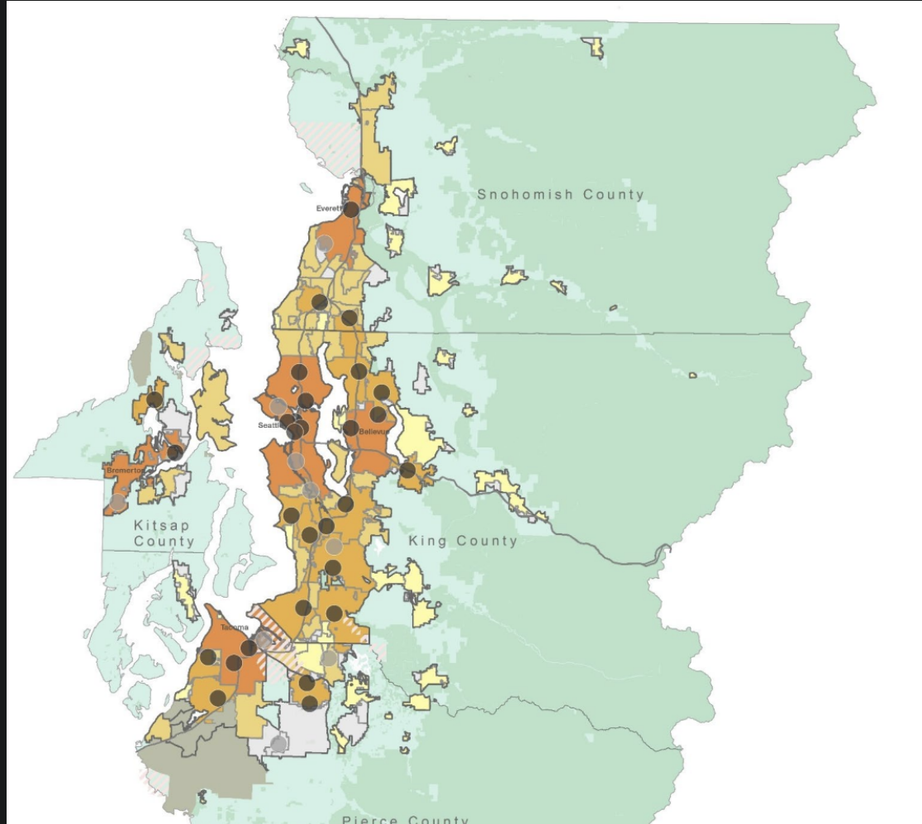
Washington
Required major cities and counties to collaborate on an Urban Growth Area
Heavily focused on Puget Sound area.
State played technical assistance role, not regulatory role.

Slide 11
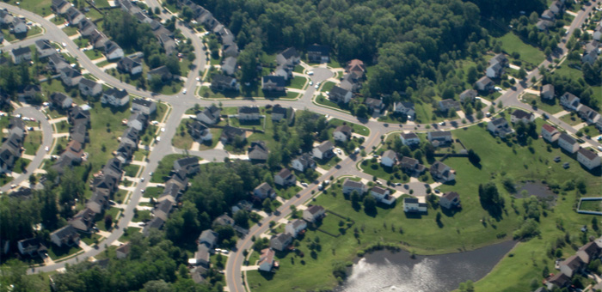
Maryland
State designated growth and preservation areas.
Invested infrastructure only in growth areas and conservation funds only in preservation areas
No regulation

Slide 12
California
Mostly locally driven with some exceptions
Tried everything:
UGBs
Concurrency
Land Conservation
Aggressive TOD
Calif version of OHNA

Slide 13
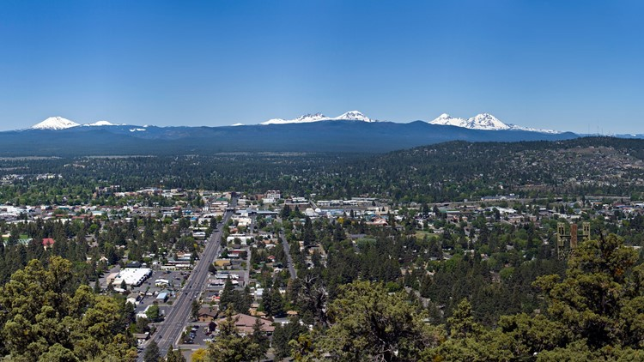
Oregon
Comprehensive
Top-Down
More Regulation
19 Goals, But Focused On Farm and Forest Protection

Slide 14
And Densities Did Go Up

Slide 15
But Things Have Changed

Slide 16
Population Has Grown Rapidly (Though It’s Currently Flat)

Slide 17
Housing Production Is Down (Though This Is Similar To Other Western States)

Slide 18
Housing Production Has Been Below Demand For Most Of The Last 30 Years

Slide 19
And Of Course Housing Prices Have Gone Through The Roof

Slide 20
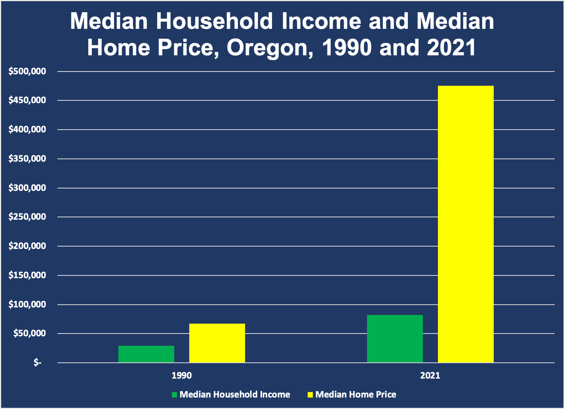
The Bottom Line

Slide 21
So WWTD? (What Would Tom Do Today?)

Slide 22
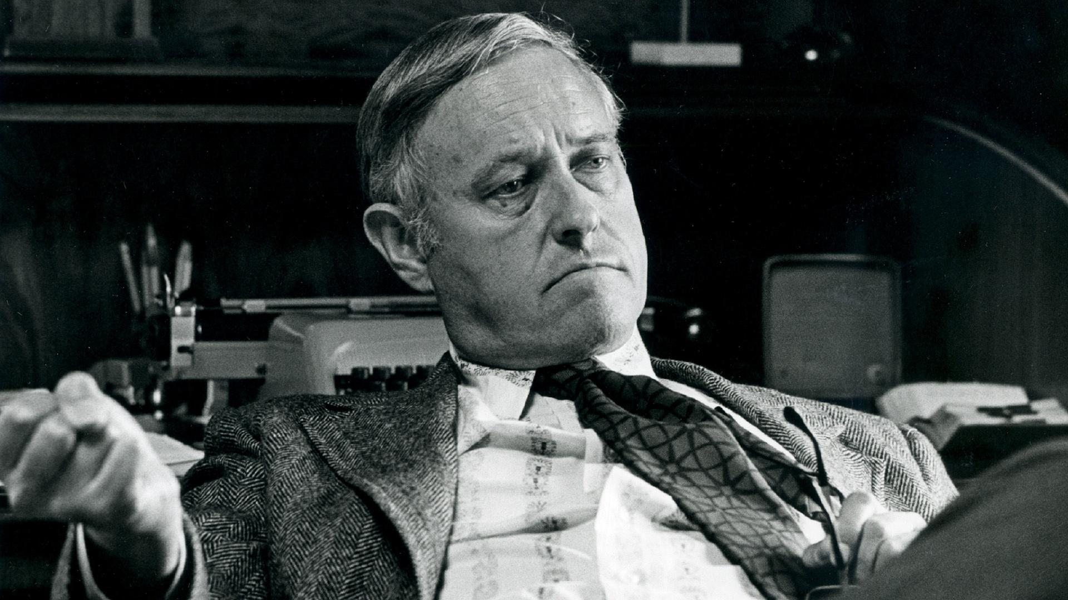
Well, in his famous speech,Tom McCall also said this:
“True quality [meaning quality of life] is absent if we allow social suffering to abide in an otherwise pristine environment.”

Slide 23
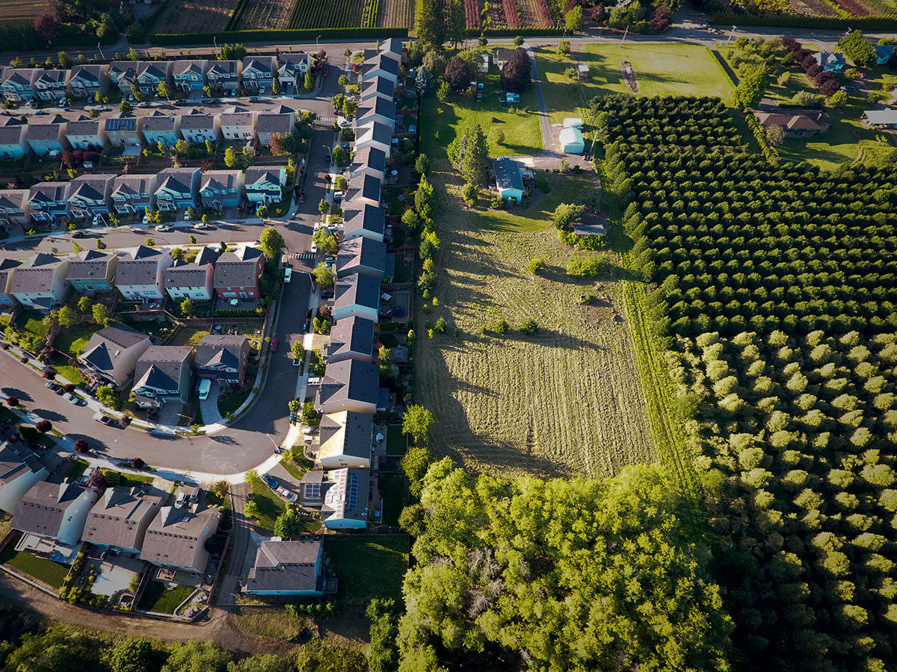
So, Maybe Some Rethinking Is In Order

Slide 24
There Are Many Reasons For The Current Situation
Supply of Buildable Land (development-ready as well as raw supply)
Construction Cost Factors
Industry Structure Factors (supply of labor and developers, type of development)
Demand factors (population growth, household formation)
Process factors (planning process, time, permitting, fees)
Source: University of Oregon

Slide 25
But How Nimble Is The Land Use System?
Currently grappling with housing AND holding on to SB 100
OHNA (Patterned after California)
CFEC (an administrative rulemaking, not a statute).

Slide 26
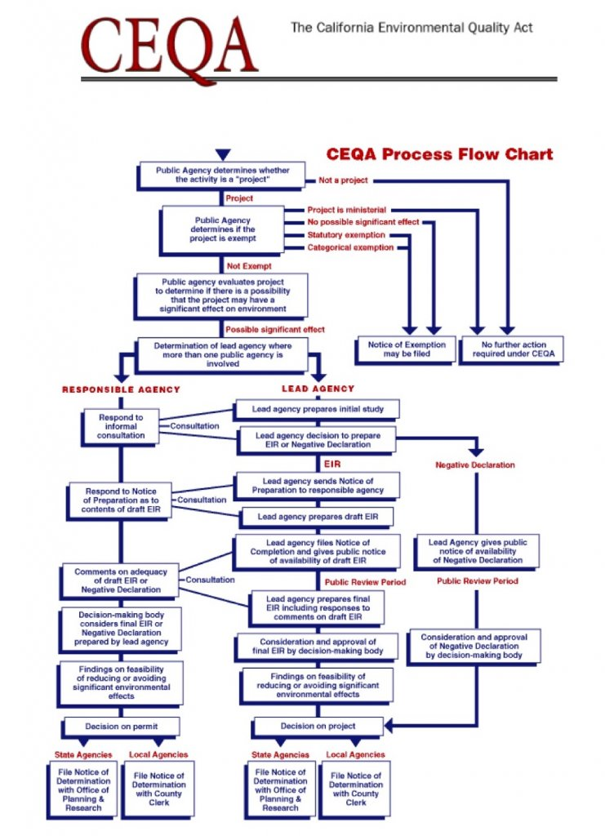
A Lesson From California
The state has tons of polices and laws
General Plan Requirements
Climate Change/VMT Reduction
Habitat Conservation
Regional Housing Needs Assessment
California Environmental Quality Act
All piled on top of one another, so that every time reform is undertaken, things get more complicated not simpler.

Slide 27
Which Leads To A Kind Of Rubik’s Cube
In theory, you can make it all work.
But everything has to fit together exactly right for it to work … which will almost certainly not happen.
And as in California, attempts to simplify the situation can get really complicated (and that of course favors the status quo).

Slide 28
So What Do You Do?

Slide 29
The Land Use Law’s Modest Goals
1. Citizen Involvement
2. Land Use Planning
3. Agricultural Land
4. Forest Lands
5. Open Spaces, Scenic and Historic Areas, and Natural Resources
6. Air, Water, and Land Resources Quality
7. Areas Subject to Natural Disaster
and Hazards
8. Recreational Needs
9. Economy of the State
10. Housing
11. Public Facilities and Services
12. Transportation
13. Energy Conservation
14. Urbanization
15. Willamette River Greenway
16. Estuarine Resources
17. Coastal Shorelands
18. Beaches and Dunes
19. Ocean Resources

Slide 30
So, Maybe A Fresh Start Is Needed
1. A few clear goals
2. Simplify, don’t complicate
3. Create simple, elegant coordination between the land use and housing laws

Slide 31
How To Get There
Although Oregon’s land use regime is unique, Oregon’s problems are not.
Don’t be afraid to learn good and bad lessons from elsewhere.
There is often comfort in making things more complicated because it tends to preserve the status quo.
But that doesn’t solve the problem.
Shouldn’t Oregon be bold?
Tom McCall was bold in response to a pressing problem of the day

Slide 32
What Can Central Oregon Do?
Well, you’re already doing a lot.
And you can’t control what goes on in Salem.
But:
Go through the excruciating process of the Housing Needs Analysis and the UGB expansions. Create elegant integration on the ground here.
Don’t forget that it is not a binary housing market. There’s a “missing middle” that you need to serve somehow!
Remember that, in the end, it’s not about planning. It’s about building housing and preserving land. Keep those goals in mind.

Slide 33
50 Years of the Oregon Land Use Act
Bill Fulton
City Club, Bend, Oregon
June 15, 2023

