Slide 2
Heather Dion, Executive Director CASA of Central Oregon

Slide 3
Myths about Foster Care and Child Welfare
Children should be “rescued” from “abusive” parents
Children in Oregon in foster care live in hotels
Foster parents are abusing the system by taking money
The point of foster care is adoption
Issue of children in foster care doesn’t affect me

Slide 4
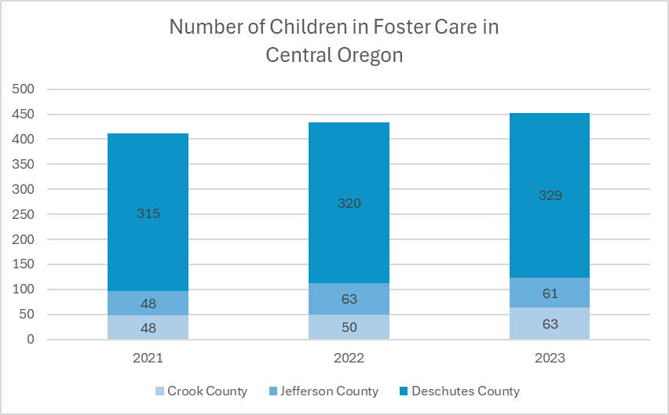
Current Data of Children in Foster Care in Central Oregon

Slide 5
Notes:
Heather-Flow Chart graphic

Slide 6
Amy Martin, Child Welfare Supervisor II for Deschutes County Oregon Department of Health and Human Services

Slide 7
CPS (Child Protective Services)
Assessing current child safety concerns
Assessing parents meeting minimum standard level of care
Notes:
Amy

Slide 8
Connecting Families to Supports
Bringing in the family and friends to help support the parents
Working with our community partners
Working with the parents in their home environment
Court involved after all other options are off the table
Notes:
Amy

Slide 9
Joe Loeb, Child Welfare Supervisor II - Permanency, Deschutes County Oregon Department of Health and Human Services

Slide 10
Adoption & Safe Families Act (1997)
Primary Plan: Reunification
Concurrent Plans:
Adoption,
Guardianship,
Another Permanent Planned Living Arrangement (16+),
Fit & Willing Relative
Notes:
Joe

Slide 11
Identifying the strengths/needs of the parents & children for intentional case planning
In-Home Safety Plan Criteria: Home-like Setting, No Barriers, Willing Parent, Safety Service Providers
Focus on building up family's natural supports: Relatives, Friends, Kith/Kin, Neighbors, Service Providers, Educators, etc.
Notes:
Joe

Slide 12
Gabrielle Allender, LCSW Director of Client Programs & Prevention KIDS Center

Slide 13
KIDS Center: Who We Are
Child Advocacy Center serving Central Oregon
Improve services and outcomes for families impacted by abuse
Collaborate closely with partners
Gather information to aid in the child abuse investigation
Notes:
Gabrielle

Slide 14
What We Do?
Trauma informed child abuse evaluation
Child shares story in one-on-one session with specially trained interviewer
Recorded and observed by law enforcement and ODHS
Child receives a child friendly head to toe medical exam.
Family gains a family advocate.
Access to evidence-based trauma therapy
Notes:
Gabrielle

Slide 15
What Can YOU Do?
It’s adults’ responsibility to protect children
Take a KIDS Center prevention training – learn signs and facts and report
Connect with families you know
Engage in community projects that strengthen supports for families
Notes:
Gabrielle

Slide 16
Paisley Pijuan, LCSW Pediatric Behavioral Health Consultant Mosaic Community Health

Slide 17
Neurobiology and the Brain What you may see in a child:
Brain
difficulty thinking, learning and concentrating
Impaired memory
Difficulty switching from 1 thought/activity to another (transitions)
Notes:
Paisley

Slide 18
Neurobiology and the Brain What you may see in a child:
Body
Inability to control physical responses to stress
Stomach aches, headaches
Chronic Illnesses (even into adulthood)
Notes:
Paisley

Slide 19
Neurobiology and the Brain What you may see in a child:
Emotions
Feeling unsafe
Difficulty regulating emotions
Difficulty with attachment and trust
Depression and or anxiety
Low self-esteem
Trouble with friendships
Notes:
Paisley

Slide 20
Neurobiology and the Brain What you may see in a child:
Behavior
Lack of impulse control
Fighting, aggression, running away
Substance use
Suicide or self-harm
Notes:
Paisley

Slide 21
Good News! - Building Resilience by Rewiring the Brain
Retrain how the brain responds to its environment
Build new pathways
Connections that are used more grow stronger and permanent
Early intervention is key
This is accomplished with patterned and repetitive behaviors
Nurturing and Connecting experiences counterbalance effects of adversity
Notes:
Paisley

Slide 22
Notes:
Paisley

Slide 23
Thank you to our annual sponsors and partners

